Slide 1


Slide 2
About today…
Arithmetic Operations
Addition
Subtraction
Multiplication
Division
Modulo
Order of Operations

Slide 3
Arithmetic Operations
Addition (+)
Subtraction (-)
Multiplication (*)
Division (/)
Modulo (%)

Slide 4
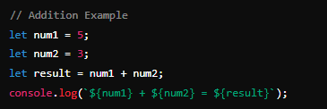
Addition Example

Slide 5
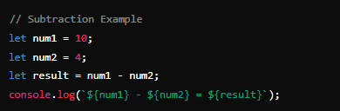
Subtraction Example

Slide 6
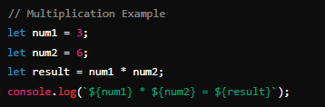
Multiplication Example

Slide 7
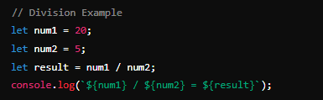
Division Example

Slide 8
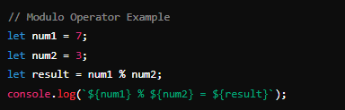
Modulo Example

Slide 9


Order of Operations
PEMDAS/BODMAS Rule
P/B
Parentheses / Brackets
First, perform operations inside parentheses or brackets
E/O
Exponents / Orders
Next, evaluate exponents (or powers) and roots
MD
Multiplication + Division
Then, perform multiplication and division from left to right
AS
Addition + Subtraction
Finally, perform addition and subtraction from left to right

Slide 10
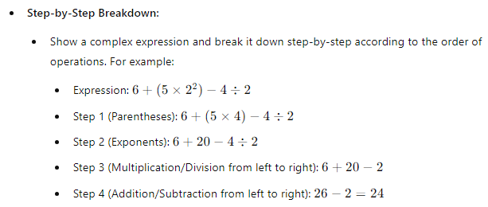
Importance
Ensures Correct Evaluation
Example

Slide 11


